Slide 1


Treat Yourself Easy Shop
Capstone 3 Final project presentation
Arie Fisher

Slide 2

Objective
Welcome to treat yourself by easy shop
The objective of the final capstone project is to take Version 1 of the e-commerce website that has already been published and develop a Version 2 of the website by modifying the project code, running various tests using unit testing and Postman, and developing new features to have a smooth-running application for consumers to enjoy.

Slide 3

Let’s Demo
Notes:
Go to Capstone 3 Script and follow the prompts to run through the code. Make sure MySql is executed with easyshop database, api I running (if modified code stop and rerun) , refresh the ui if needed. Talk through Phase 1 and 2 using the excel spreadsheet.

Slide 4
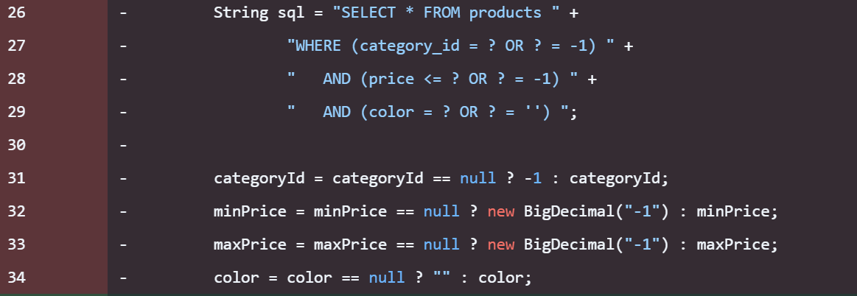
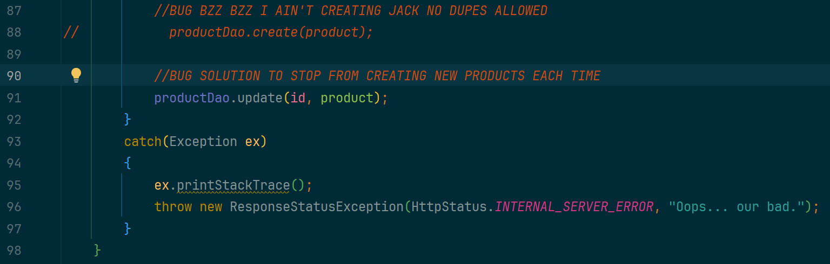
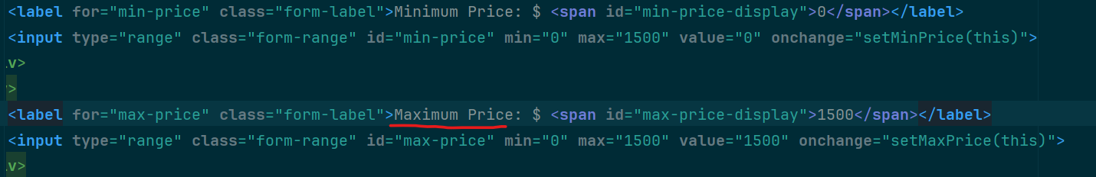
Got Bugs?
Product Search Functionality
Location: My SqlProductDao
Solution:
Bug 1 was about fixing the product search so it works when people pick different filters. I used 'WHERE 1=1' to start the search, then added more pieces to the search only if the user picked a filter. The 'parameterNumber' helps match the question marks to the right values.
Bug 1
Bug 2
Bonus Bug
Duplicate Products
Location: ProductsController
Solution: update instead of create or else it will make a new one each time
Min/Max Typo on UI Website
Location: UI Project home.html
Solution: Change one of the minimum to maximum

Slide 5
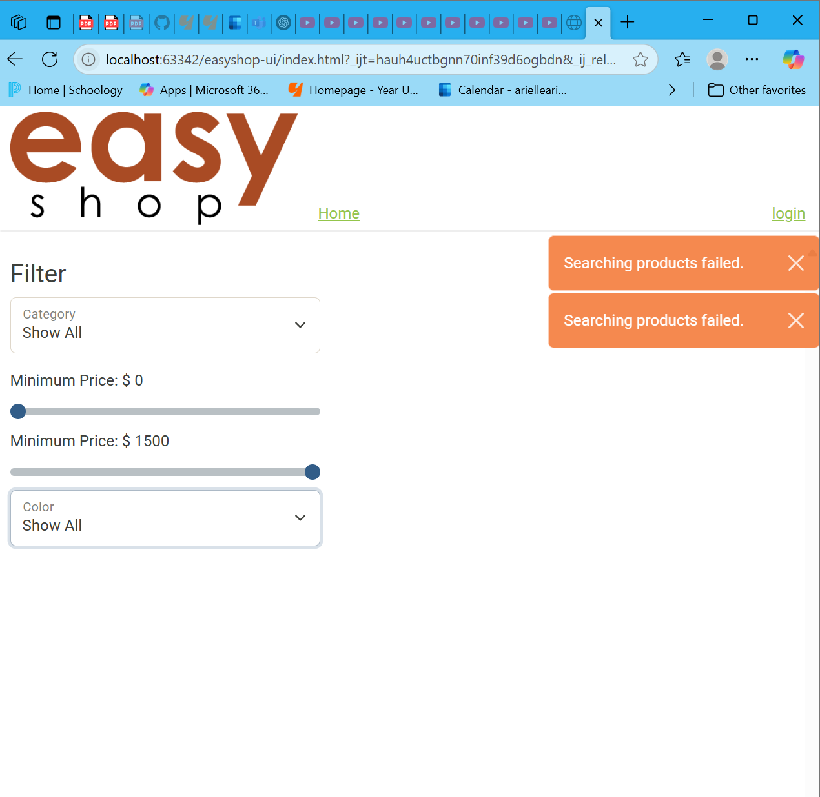
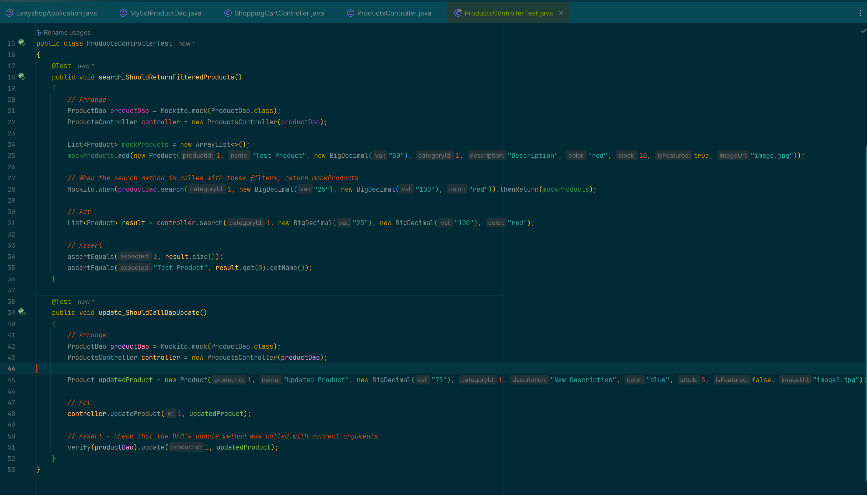
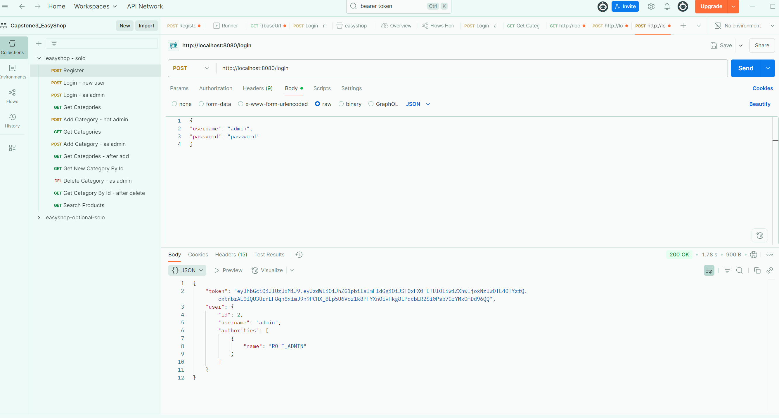
Testing 1,2,3
UI Testing
Unit Testing Bug 2
Before I started..
Postman

Slide 6
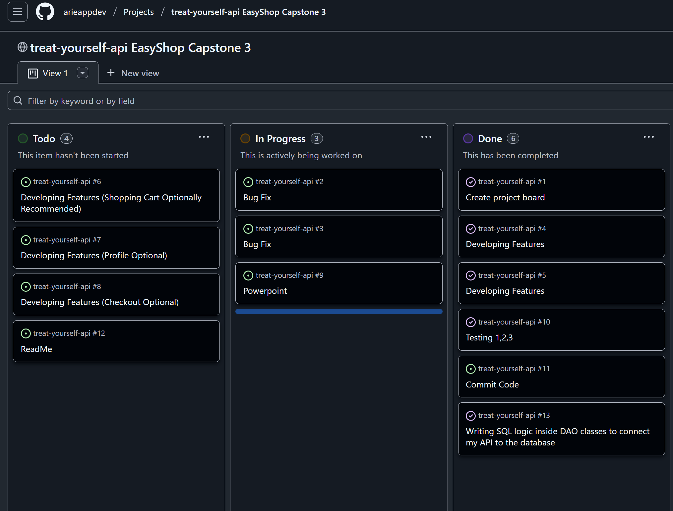
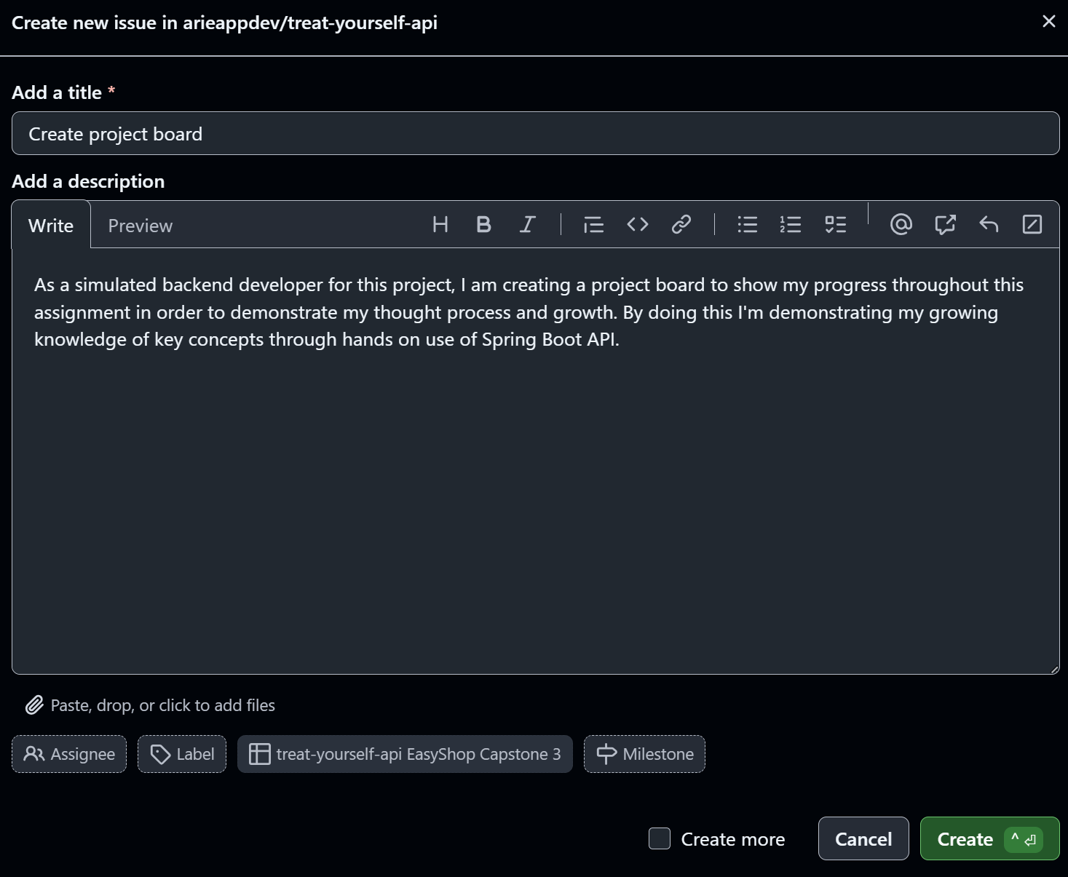
Project Board

Slide 7
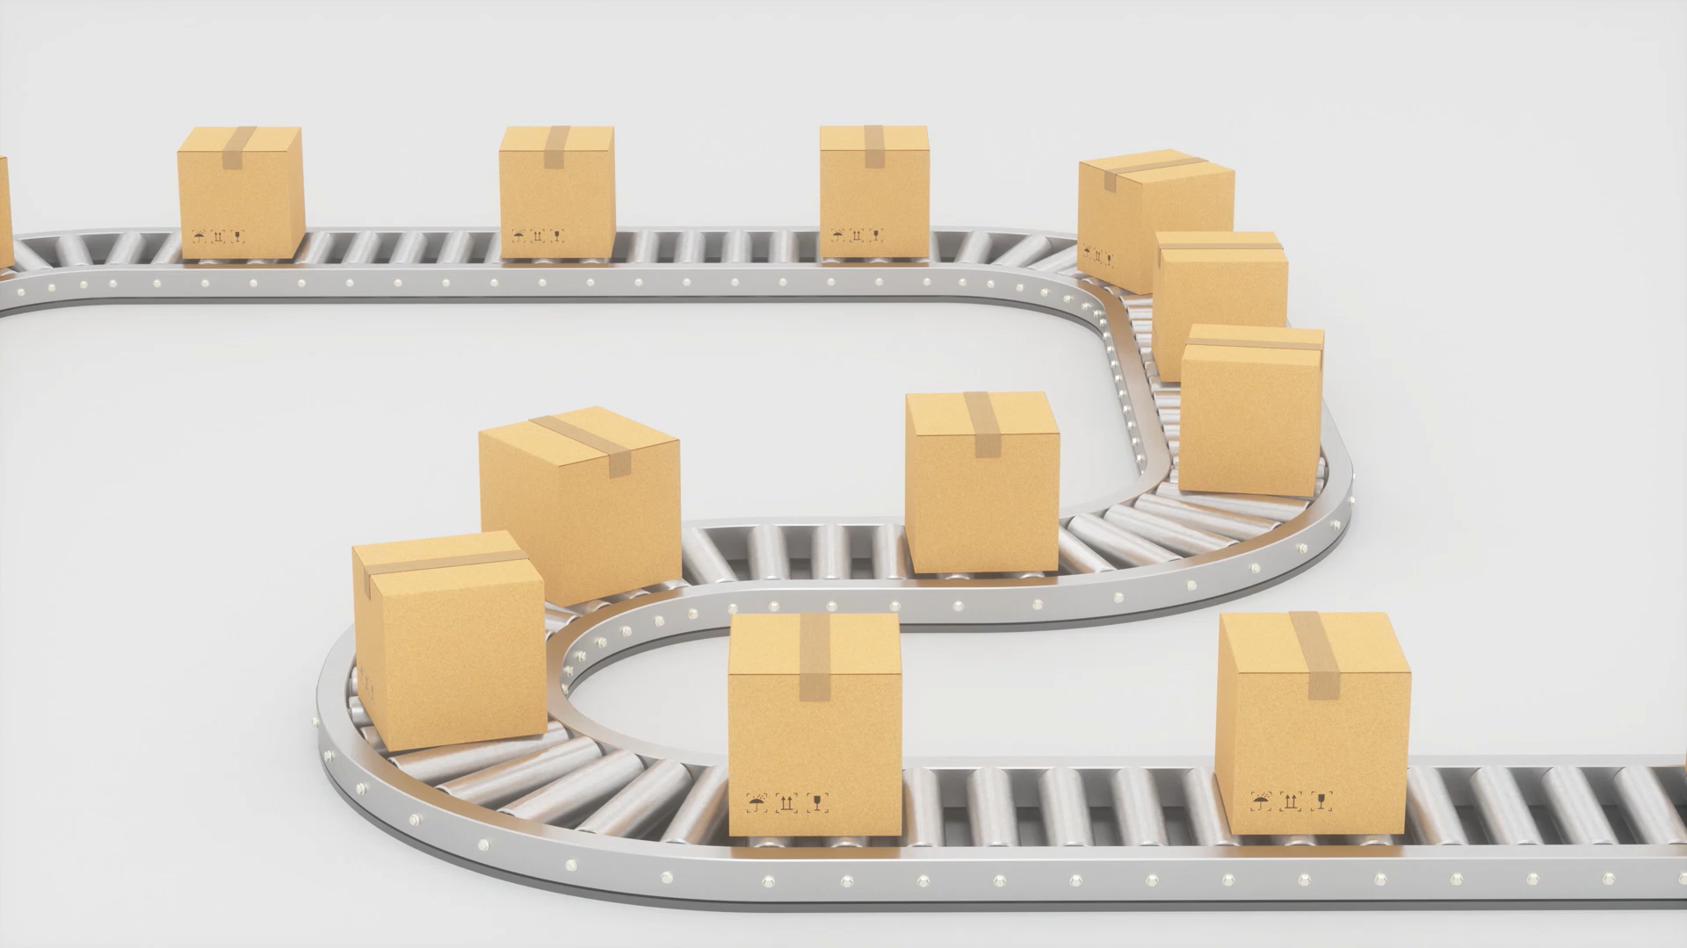
Future Feature Versions
Shipping
Fast Shipping vs Standard Shipping
Gifting
Sending an item as a gift
Pick Up In Store
Having product available in a nearby store location to get quicker than waiting for shipping

Slide 8
Challenges
Let’s Reflect…
I went through the 6 stages of project panic playing seek and find through a ton of code in hopes to find a solution.
The 6 Stages of Project Panic (Anxiety Edition):
Denial — “I’ve got time… it’ll be fine.”
Dread — “Wait… this is due tomorrow?”
Overthinking — “What if my code breaks in front of everyone? What if I forget how to talk?”
Productivity Frenzy — “Okay, I’m locking in. I’m not sleeping. We’re finishing this.”
Existential Crisis — “Why did I pick this career? Maybe I’ll just move to the mountains…”
Relief (or Collapse) — “It’s done. I survived. Never again… until next time.”
What I find fulfilling instead? Being able to design and build from scratch. I think it speaks to my entrepreneur side. I’m thankful so this opportunity to learn and grow and try my hand at coding. I got a lot farther than I thought I would.
Another challenge would be figuring out where to begin and focusing on 1 task at a time. I felt that when I started a task I ran into another future task and wanted to move on to that without the task that I finished. Backend makes me overwhelmed.

Slide 9
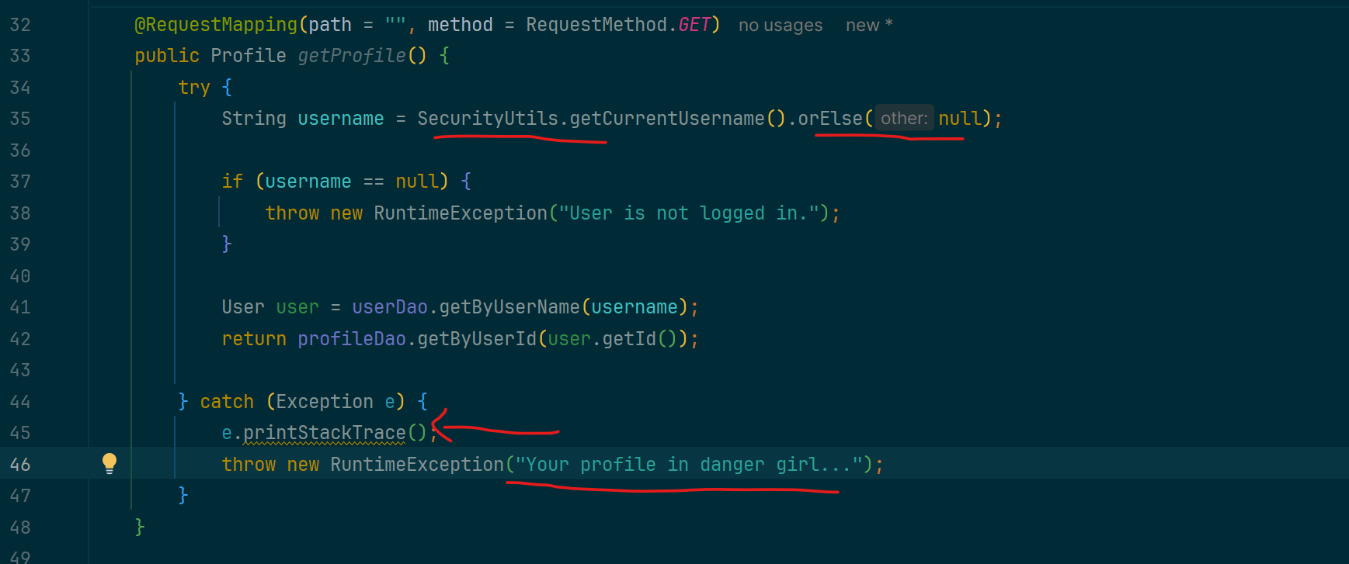
Interesting Code
When creating the profile controller, I thought about authentication. I searched for classes dealing with security and authentication. I wanted to practice utilizing code I was already given. I saw that the SecurityUtils class was an instance of userDetails, which was used throughout the classes dealing with the profile so I explored how to use it.
This code lets a logged-in user get their profile. It uses @RequestMapping to handle a GET request. First, it checks who’s logged in with SecurityUtils. If no one’s logged in, it gives an error. If they are, it finds their user information and returns their profile from the database.

Slide 10

What I Learned?
Multiple ways to test/debug
Postman
Unit Testing
Through the UI website
Saving in Postman
If you don’t hit the save button you may have ran tests but the results will not show and you have to start over and redo tokens and it’s a hot mess
Being a developer is time consuming
It requires a lot of back and forth and paying attention to detail. It makes you second guess things and can be annoying but rewarding at times.

Slide 11

The End
Thank you craig! We will miss you so much!!!
Arie Fisher

